Slide 1
Spark Lab

Slide 2
Agenda
Spark Architecture
Spark Context
Resilient Distributed Dataset
Intro to Python
Running pyspark:
Interactive
Batch
Transformations
Actions
Caching RDD’s
Spark Program Life Cycle
Key Value Transformations
Word count
Closures, Accumulators and Broadcast variables
Batch processing with Spark

Slide 3

Spark Drivers and workers
Spark has two main programs, driver and worker program.
Spark context object in your driver program, will coordinate with cluster manager. In hadoop it will he resource manager.
Get the required resources for running the job.
Now connects to executors in worker node, all the computations run in worker nodes where data is residing. In hadoop, it would be data nodes.

Slide 4
Spark Architecure; key points
Each application gets its own executor processes.
Spark is agnostic to the underlying cluster manager. It can work with Mesos, YARN.
Driver will be coordinating with workers.
Spark supports three cluster managers:
Standalone
Apache Mesos
Hadoop YARN
In our lab, Spark will be coordinating with Yet Another Resource Negotiator(YARN)

Slide 5
Spark Context
Driver program in spark creates spark context object.
Configurations in spark context will decide in which mode it will be running. If spark context is configured with YARN, it will run on Hadoop.
In interactive analysis, spark context will be automatically created as sc.
In batch programming it should be explicitly created by using SparkContext class.

Slide 6
Resilient distributed dataset
Primary abstraction in spark:
Fault tolerant collection of elements which can be operated parallel
Immutable once constructed
Track lineage information to efficiently compute lost data
You construct RDDs:
parallelizing an existing collection in your driver program
referencing a dataset in an external storage system such as HDFS, Hbase, S3
Or from existing transformations

Slide 7
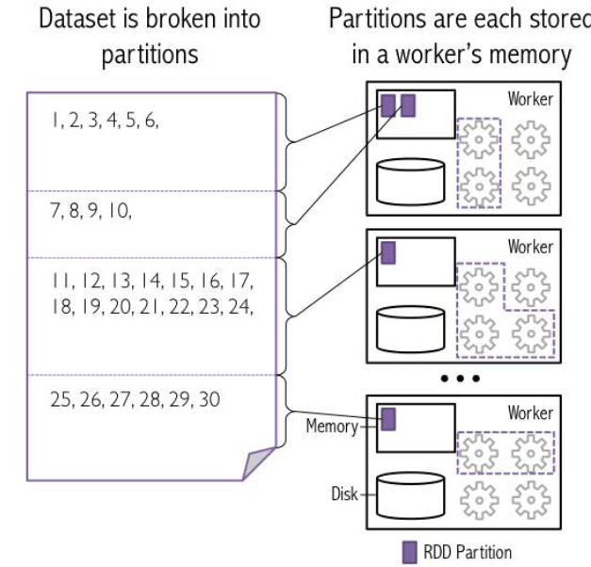
RDDs
Programmer specifies the number of partitions for an RDD.
Then partitions are stored in workers memory.
Each partition can be allocated a core on the
Worker machine, when the actual execution begins

Slide 8
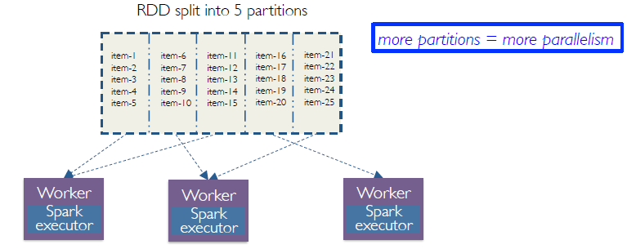
More partitions, more parallelism
Default would be chosen, if not specified.
If spark is running on Hadoop, user need not mention the number of partitions, as data is already partitioned on HDFS.

Slide 9
RDD Operations
Two types of operations can be performed on RDD’s, Transformations and actions.
Transformations are lazy
In-fact Transformations will be only executed when action runs on it.

Slide 10

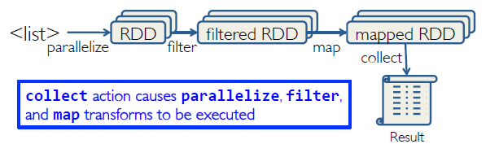
Working with RDD’s
Create an RDD from data source:
Apply transformations
Apply actions to get results out of it.
In this example, parallelize is a function to create RDD from list.
Filter and Map are transformations.
Collect is the action, which starts the entire process.

Slide 11
Creating RDD’s
From existing collections in Python:
list = [1,2,3,4,5]
rdd = sc.parallelize(list,4)
Here 4 refers to number of partitions.
From raw files in HDFS or any other external system.
rdd = sc.textFile(‘PathOfFile’,4)

Slide 12
Spark Transformations
Creates new datasets from existing one’s.
All spark transformations are lazy
Using lazy evaluation, spark does not compute results right away. Spark remembers set of transformations applied to base dataset
Spark optimizes the required calculations
Spark recovers from failures and slow workers
Think of this a recipe for creating end result.

Slide 13
Review Python lambda functions
Small anonymous functions(not bound to any name)
lambda a,b: a+b
a,b are inputs
a+b is what it returns
Restricted to a single expression
Can be used where ever function objects are required.

Slide 14
Key notes before we start the lab
Spark is more similar to functional programming language, so you as developer, get to know the functions available in spark, use them wisely to solve your data analysis problems.
Like map reduce, don’t try to focus on writing complex programs, keep it simple, get your logic write, and then start programming.
Reason for choosing python for this lab, its simple, easy and fun to learn. Python has rich set of libraries for data analys
If you know spark programming in python, you can also do similar stuff in Scala. Since spark is functional programming language, functions will be similar across different programming platforms, syntax and semantics might change!

Slide 15
Spark is both interactive and batch. Since there are many users accessing lab environment in parallel, we chose to use batch processing. Instructors will demonstrate you interactive shell.

Slide 16
Transformations
map
filter
distinct
union
Intersection
flatMap

Slide 17
map
Description:
Returns a new distributed dataset formed by passing each element of a source through a function func.
In spark, map function works on individual elements, and can also be used to create key value pair RDD. Element level operations like split, concatenate, lower, upper can be used with map.
In SQL it can be compared to select operation.
Code:
### Create source RDD, the same will be used for the coming examples
sourceRDD = sc.parallelize([51,44,11,12,14,5,6,3,3,1,7,7,11],4)
### Transform elements using map
mapRdd = sourceRDD.map(lambda x:x+1)
### Get the results out of RDD using action collect
mapResult = mapRdd.collect()
### Print the results
print(mapResult)
Result:
[52, 45, 12, 13, 15, 6, 7, 4, 4, 2, 8, 8, 12]

Slide 18
filter
Description:
Return a new dataset formed by selecting those elements of the source on which func returns true.
Examples: Customers from a particular region, products with sale more than 1000.
In SQL it can be compared to where condition.
Code:
# Filtering condition to get even elements
filterRDD = sourceRDD.filter(lambda x:x%2==0)
# Get the result from RDD using collect action
filterResult = filterRDD.collect()
# check the output
print(filterResult)
Result:

Slide 19
Distinct
Description:
Return a new dataset that contains the distinct elements of the source dataset.
Example: Distinct number of customers who have done transactions today.
In SQL, it can be compared to distinct.
Code:
Code:
# Distinct function to get distinct elements
distinctRDD = sourceRDD.distinct()
# Get the results from distinctRDD
distinctResult = distinctRDD.collect()
# Print results
print(distinctResult)
[1, 3, 5, 6, 7, 12, 11, 44, 14, 51]
if you see, sourceRDD has two 11, after distinct you see only one 11.
Result:

Slide 20
Union
Description:
Returns union of two datasets.
Similar to union function in SQL.
Code:
# Create two sample RDD's
rdd1 = sc.parallelize([1,6,12,5,8,9])
rdd2 = sc.parallelize([1,12,11,5,9,7])
# union on Two RDD's
unionRDD = rdd1.union(rdd2)
# Get the result
unionResult = unionRDD.collect()
print(unionResult)
[1, 6, 12, 5, 8, 9, 1, 12, 11, 5, 9, 7]
Result:

Slide 21
Intersection
Description:
In mathematics, the intersection A ∩ B of two sets A and B is the set that contains all elements of A that also belong to B but no other elements.
Code:
# Intersection on Two RDD's
intersectionRDD = rdd1.intersection(rdd2)
# Get the result
intersectionResult = intersectionRDD.collect()
print(intersectionResult)
[12, 1, 5, 9]
Result:

Slide 22
flatMap
Description:
similar to map, but each input item can be mapped to 0 or more output items (so func should return a
Seq rather than a single item).
`
Code:
1
# Let us find word count
linesRDD=sc.parallelize(["map reduce is spark","spark is version of map reduce","Spark map reduce next version"])
2
3
# split function in python would return list of words
wordsList=linesRDD.map(lambda line:line.split(" "))
# Check the output
wordsListOp = wordsList.collect()
print(wordsListOp)
# Now if we even do a count, what we get is sentences count, not word count
sentenceCount = wordsList.count() print(sentenceCount)
3
# lets try flat map
words=linesRDD.flatMap(lambda line:line.split(" "))
# check the output
wordsop=words.collect()
print(wordsop)
# Since the words are seperated, word count is easy to make
wordCount=words.count()
print(wordCount)
15
[['map', 'reduce', 'is', 'spark'],
['spark', 'is', 'version', 'of', 'map', 'reduce'],
['Spark', 'map', 'reduce', 'next', 'version']]
['map', 'reduce', 'is', 'spark', 'spark', 'is',
'version', 'of', 'map', 'reduce', 'Spark', 'map',
'reduce', 'next', 'version']

Slide 23
How to get results out of Transformations?
lines = sc.textFile("pathoffile")
comments = lines.filter(someLogic)
Spark will not execute as transformations are lazy.
Spark remembers the transformations, and they act as a recipe.

Slide 24
Spark Actions
Actions causes spark to execute the transformations.
Actions are the mechanism to get results out of transformations

Slide 25
Actions
reduce
collect
count
first
take
takeOrdered

Slide 26
reduce
Description:
aggregate dataset’s elements using function func. func takes two arguments and returns one, and is commutative and associative so that it can be computed correctly in parallel
Code:
# Get the total sum of all number in source RDD
total = sourceRDD.reduce(lambda a,b:a+b)
# Check the results
print(total)
Output: 175
# now we can get average
average = total*1.0/count
print(average)
13.4615384615

Slide 27
count
Description:
Returns the number of elements in RDD
Code:
count = sourceRDD.count()
# Check the results
print(count)
13

Slide 28
collect
Description:
Return a list that contains all of the elements in this RDD. Note that this method should only be used if the resulting array is expected to be small, as all the data is loaded into the driver’s memory.
Code:
collectResult = sourceRDD.collect()
# Check the results
print(collectResult)
[51,44,11,12,14,5,6,3,3,1,7,7,11]

Slide 29
first
Description:
Returns the first element in RDD
If you want to get an understanding of data, you can use first. This will give you glance of data
Code:
first= sourceRDD.first()
# Check the results
print(first)
51

Slide 30
take
Description:
Returns the first n elements in RDD. Where n refers to number of elements
Take will be very handy, when you have very large data, and you want to have a look at few records, use take and mention the number of elements
Code:
take5= sourceRDD.take(5)
# Check the results
print(take5)
[51,44,11,12,14]

Slide 31
takeOrdered
Description:
Return n elements ordered in ascending order or as specified by the optional key function. n refers to number of elements to return.
In SQL it is similar to order function. By default, it only does ascending sort. If you want to get in descending or some other order, then define a function which will help takeOrdered function to get the position of elements to be displayed.
Code:
ascending = sourceRDD.takeOrdered(5)
# Check the results
print(ascending)
[1,3,3,5,6]

Slide 32
takeOrdered contd..
Description:
Now we need descending order, how to make ascending descending???
Write a function which will negate the elements in RDD. Asceding order of negative values will be descending. This way, although takeOrdered does ascending to find the positions of elements to be displayed in order, it becomes descending
Code:
descending = sourceRDD.takeOrdered(5, lambda x: -1*x)
# Check the results
print(descending)
[54,44,14,12,11]

Slide 33
Lets understand spark programming model
First convert raw data or collections to RDD’s.
Use transformations to transform data.
Use actions to get results.
Transformations are lazy.
Actions will execute transformations and bring out results
But there is a problem…..!!

Slide 34
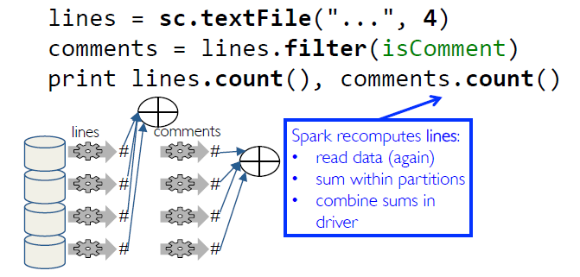
Consider you are doing multiple computations on the same RDD

Slide 35
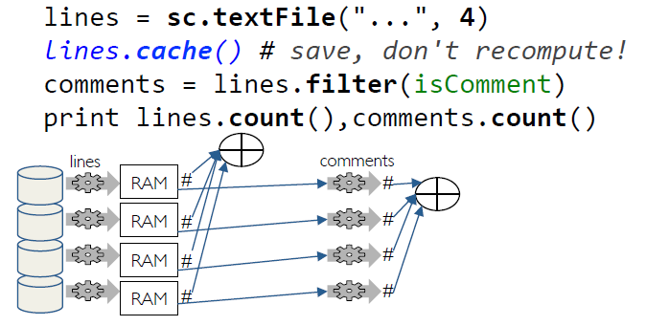
Caching RDDs

Slide 36
Spark Program life cycle
Create RDD’s from data on disk or existing collections
Do relevant transformations based on your data analysis requirements
Cache frequently used RDD’s
Perform actions to execute parallel computation and produce results

Slide 37
Spark Key Value RDD’s
Like mapreduce, spark supports key-value pairs
Each element of a pair RDD is pair tuple.
Key value pairs, only work on pair tuple. By default, the first element in the tuple will become key, and rest will be values.
rdd = sc.parallelize([("a", 1), ("b", 1), ("a", 1)])
Here a,b,a are keys, 1 is the value

Slide 38
Some key value RDD’s
reduceByKey
sortByKey
groupByKey
join

Slide 39
reduceByKey
Description:
return a new distributed dataset of (K, V) pairs where the values for each key are aggregated using the given reduce function func, which must be of type
(V,V) →V
Here function will only work on values, not keys. Don’t get confused
Code:
# Reduce By Key
keyValueRDD = sc.parallelize([(1,2),(2,4),(3,2),(1,2),(2,4),(3,2)])
reduceByKeyRDD = keyValueRDD.reduceByKey(lambda a,b:a+b)
results = reduceByKeyRDD.collect()
print(results)

Slide 40
sortByKey
Description:
When called on a dataset of (K, V) pairs where K implements Ordered, returns a dataset of (K, V) pairs sorted by keys in ascending or descending order, as specified in the boolean ascending argument.
Syntax = sortByKey([ascending], [numTasks])
If the first argument is true, ascending sort is implemented, false descending.
Code:
sortByKeyRDD = keyValueRDD.sortByKey()
sortedResults = sortByKeyRDD.collect()
print(sortedResults)

Slide 41
groupByKey
Description:
Group by key is like shuffle in map reduce.
All the relevant values of key will be grouped.
After grouping, one can perform a relevant summarization.
groupByKey involves lots of data movement.
Code:
groupByKeyRDD = keyValueRDD.groupByKey()
sumResults = groupByKeyRDD.map(lambda (k,v):(k,sum(v))
print(sumResults)

Slide 42
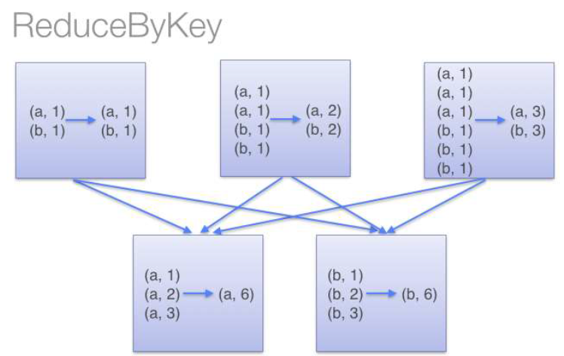
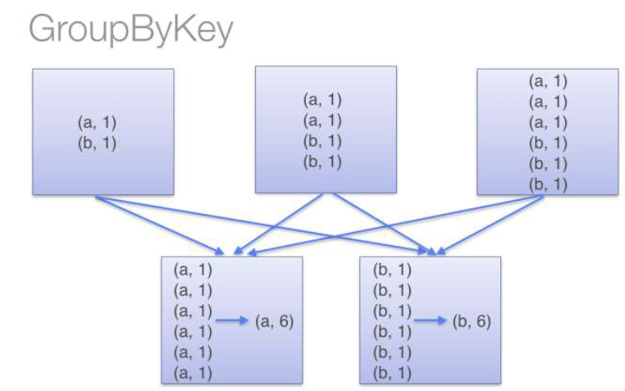
groupByKey vs reduceByKey: WordCount Problem
reduceByKey will do local reduction at each partition, and then will perform global reduction.
For an overall summary, reduceByKey can be used.
Example: Region wise sales, Region wise customer sales.
groupByKey will first shuffle the data, separate each key to different partitions and then do reduction operation.
In a specific group, if a particular operation needs to be performed, then groupByKey makes sense.
Example: Each region, top 10 customers.

Slide 43
join
Description:
join function, joins two RDD’s on the key’s.
Code:
x = sc.parallelize([("a", 1), ("b", 4)])
y = sc.parallelize([("a", 2), ("a", 3)])
joinedRDD = x.join(y)
joinedResult = joinedRDD.collect()

Slide 44
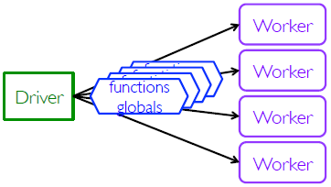
closures
Spark automatically creates closures for:
Functions that run on RDDs at workers
Any global variable used by those workers

Slide 45


pySpark Shared Variables
Broadcast Variables
Efficiently send large, read-only value to all workers
Saved at workers for use in one or more Spark operations
Like sending a large, read-only lookup table to all the nodes
Similar to distributed cache in map reduce
Accumulators
Aggregate values from workers back to driver
Only driver can access value of accumulator
For tasks, accumulators are write-only
Use to count errors seen in RDD across workers
Similar to counters in map reduce

Slide 46
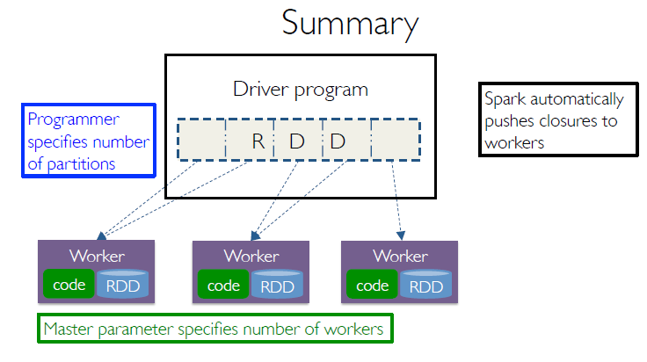
In YARN, driver program will be launched on application master.
Workers are containers at node managers.
In HDFS, you need not mention the number of partitions, as data is already partitioned. If you mention the number of partitions, and it is less than partitions on HDFS, it will not consider. If more, then data partitioned on HDFS will be further partitioned.

Slide 47
Word count on a text file
Copy UN .txt to HDFS and provide the path of HDFS file
fileRDD = sc.textFile("UN.txt")
wordsRDD = fileRDD.flatMap(lambda line:line.split(" "))
wordsRDD.take(4) # Check
wordsKeyValueRDD = wordsRDD.map(lambda word: (word.lower(),1)) # Convert to lower case
wordsKeyValueRDD.take(4) # Check
wordCountRDD = wordsKeyValueRDD.reduceByKey(lambda a,b:a+b)
wordCountRDD.take(4) # Check
wordCountRDDFlip = wordCountRDD.map(lambda (k,v):(v,k))
wordCountRDDDesc = wordCountRDDFlip.sortByKey(False)
wordCountRDDDesc = wordCountRDDDesc.map(lambda (k,v):(v,k))
wordCountRDDDesc.take(5) # Check # Save the output
wordCountRDDDesc.saveAsTextFile(“WordCount")

Slide 48
All in one command
(fileRDD.flatMap(lambda line:line.split(" "))
.map(lambda word: (word.lower(),1))
.reduceByKey(lambda a,b:a+b)
.map(lambda (k,v):(v,k))
.sortByKey(False)
.map(lambda (k,v):(v,k))
.saveAsTextFile("/home/training/Desktop/WordCount2"))

Slide 49
Spark batch mode
Save the commands in a file with .py extension.
To run it in batch mode, use the following command:
spark-submit wordcount.py

